Slide 1
Memory Management
Part 3
Memory Management Strategies
Virtual Memory Management

Slide 2

Hashed Page Tables
Use a hashed page table for handling address spaces larger than 32 bits
Hash value is the virtual page number
Each entry in the table contains a linked list of elements that hash to the same location
Each element consists of three fields
The virtual page number
The value of the mapped page frame
A pointer to the next element in the linked list
Working of the algorithm

Slide 3
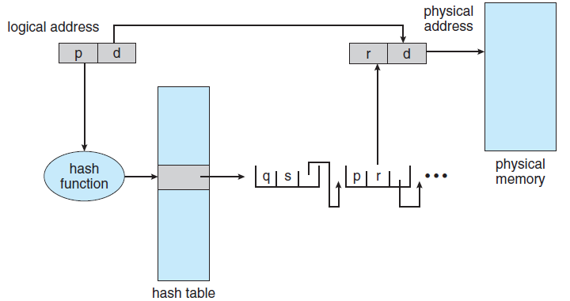
Hashed Page Table
Notes:
3

Slide 4
Hashed Page Tables
Clustered page tables
A variant of the 32-bit scheme mentioned before
Suitable for 64-bit address spaces
Difference from hash table
Each entry in the hash table refers to several pages in clustered page table
A single page-table entry can store the mappings for multiple physical-page frames
This is especially useful for sparse address spaces
Where memory reference is noncontiguous and is scattered throughout the address space

Slide 5
Inverted Page Tables
Each page table consists of millions of entries
Consume large amount of memory
Solution
Use inverted page table
It has one entry for each frame of memory
It contains the virtual page address and the id of the process that owns the page
Only one page table exists in the system
Working of the inverted page table
The scheme decreases the amount of memory consumed by the page table

Slide 6
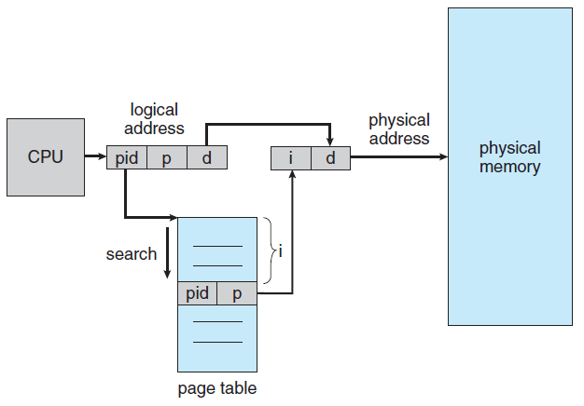
Inverted Page Table Architecture
Notes:
6

Slide 7
Inverted Page Tables
Problem
Increases the amount of time required to search the table
Entire table needs to be searched in worst case
Use hash table to alleviate the problem
At least two memory accesses are required to get a frame address
TLB is searched before any of the above operations
Systems using inverted page table have difficulty in implementing shared memory
Allow the page table to contain only one mapping of the virtual address to the shared physical address

Slide 8
Example: ARM Architecture
Most mobile devices use ARM processors
32-bit ARM processors support
4K and 16K page sizes
1MB and 16 MB pages termed as sections
1-level paging is used for 1MB and 16MB sections
2-level paging is used for 4KB and 16KB pages
Address translation in ARM MMU
ARM also supports two levels of TLBs
Outer level Micro TLBs
Data TLB and instruction TLB
Micro TLBs also support ASIDs
Inner level main TLB
Address translation starts at the micro TLB level
In case of miss, main TLB is accessed

Slide 9
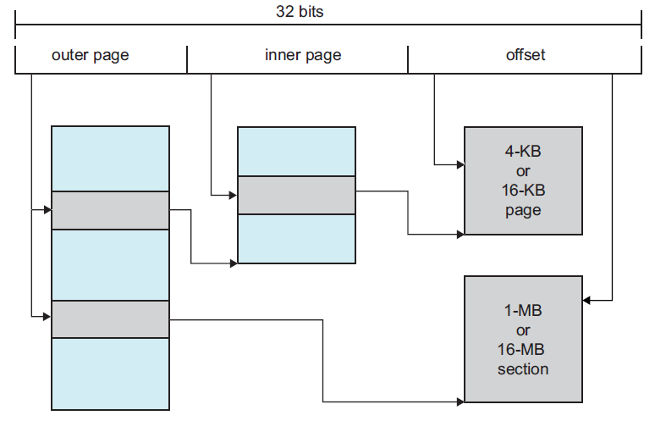
Logical Address Translation in ARM

Slide 10
Virtual-Memory Management
Benefits of Virtual Memory
Demand Paging
Principle of Working-set Model
Shared memory and Memory-mapped files
How to manage Kernel memory

Slide 11

Virtual-Memory Management
Virtual address space
Demand paging
First reference and Page fault
Page fault rate
Page replacement algorithms
FIFO Optimal
LRU Second chance
Frame allocation policy
Fixed and dynamic
Working-set Model
Thrashing
Contiguous allocation of pages
Buddy system and slab allocation
I/O locking and pre-paging

Slide 12
Introduction
Multiprogramming requires that entire processes are in memory before they start execution
Virtual memory allows execution of processes that are not completely in memory
Programs can be larger than physical memory
Frees programmers from the burden of memory-storage limitations
Sharing of files and memory can be implemented easily
It provides an efficient mechanism for process creation
May decrease performance if used carelessly
Demand paging, its complexity and cost

Slide 13
Background
Dynamic loading can be used to run processes that are larger than the allocated memory
Requires special precautions and extra work by the programmer
In many cases, the entire program is not needed for execution
Programs have code to handle unusual error conditions
Arrays, lists and tables are allocated more memory than they actually need
Certain options and features of a program may be used rarely
Even if the entire program is needed, it may not all be needed at the same time

Slide 14
Background
The benefits of executing partially loaded programs
Program is not constrained by the amount of available physical memory
More programs can be run at the same time
More CPU utilization and higher throughput
Each user program runs faster
Less I/O is needed to load or swap user programs
Virtual memory allows for the separation of user address space and physical address space
Allows a large virtual address for a small physical memory

Slide 15
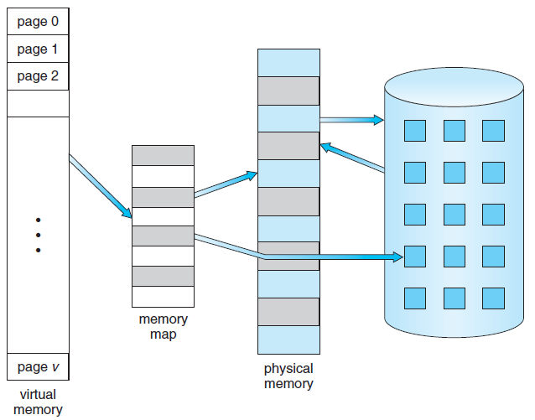
Virtual Memory That is Larger Than Physical Memory
⇒
Notes:
15

Slide 16
Background
Virtual address space of a process: Logical view of how a process is stored in memory
This is contiguous
Physical frames are distributed in memory
Virtual address spaces that includes holes are referred as sparse address spaces
Useful for stack or heap segments
Page sharing is implemented easily in virtual memory
Benefits
System libraries can be shared by processes
Virtual memory enables processes to share memory for interprocess communication
Process creation can be sped up by allowing pages to be shared using fork() system call

Slide 17
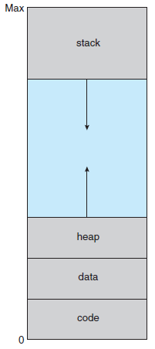
Virtual-address Space
Notes:
17

Slide 18
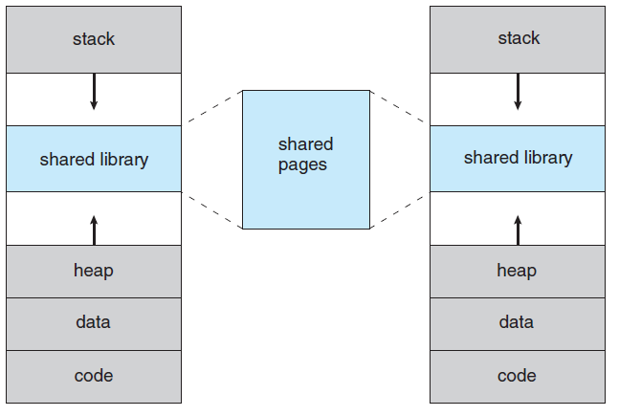
Shared Library Using Virtual Memory
Notes:
18

Slide 19
Demand Paging
Load pages of a process into memory as they are needed
Demand paging
Commonly used technique in virtual memory
Similar to a paging system with swapping
Processes reside in secondary memory
Swapped into memory for execution by using a lazy swapper
Lazy swapper never swaps a page into memory unless that page will be needed
Pager manipulates individual pages

Slide 20
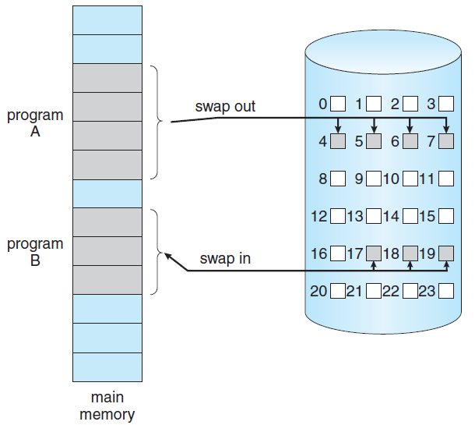
Transfer of a Paged Memory to Contiguous Disk Space
Notes:
20

Slide 21
Basic Concepts of Demand Paging
When a process is brought into memory
Only a subset of its pages are loaded
Pager avoids reading into memory the pages that will not be used
Hardware support is required to distinguish between pages that are in memory and the ones that are on the disk
Valid-invalid bit can be used for this purpose
If the access is limited to memory-resident pages
Execution proceeds normally
If the process tries to access a page not brought into memory
It causes a page-fault trap

Slide 22
Valid-Invalid Bit
Frame #
valid-invalid bit
v
v
v
v
i
….
i
i
page table
Notes:
22

Slide 23
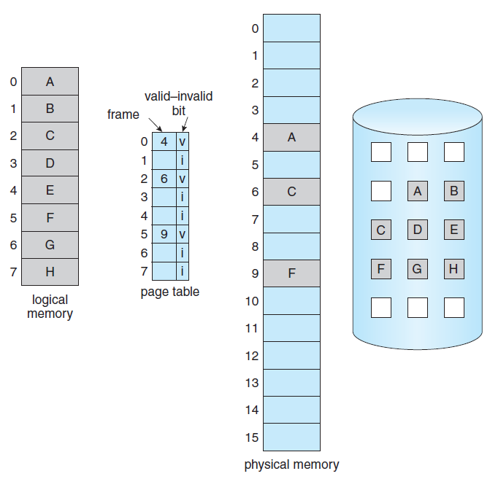
Page Table With Some Pages Not in Main Memory
Notes:
23

Slide 24
Demand Paging
Procedure followed for handling the page fault
Check an internal table (kept in PCB) to determine the validity of the reference
In case of invalid reference, process is terminated
If the reference is valid, the referenced page is to be brought in
Find a free frame from a free frame list
Schedule a disk operation to read the desired page into the allocated frame
Modify the internal table of the process to record this change
Restart the instruction that was interrupted due to the trap

Slide 25
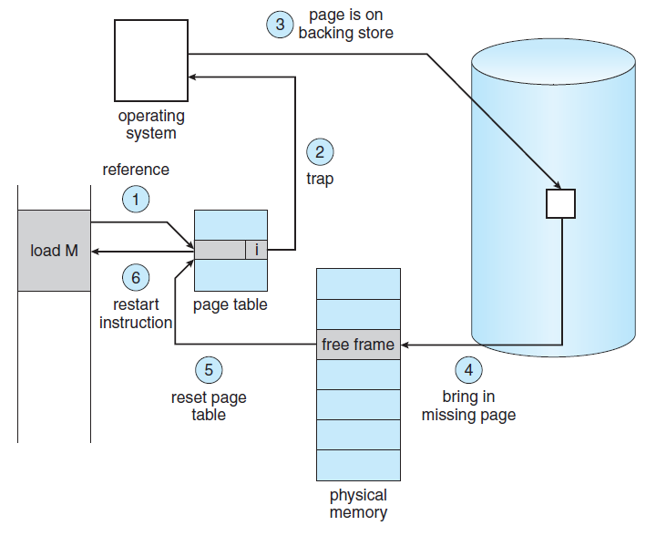
Steps in Handling a Page Fault
Notes:
25

Slide 26
Demand Paging
Pure demand paging
A process starts with no page in memory
It faults a number of times to load the required pages
Some programs may generate multiple page faults per instruction
This results in unacceptable system performance
Programs tend to have locality of reference
This results in reasonable performance from demand paging
Hardware to support demand paging
Page table with the ability to mark a page as valid or invalid
Secondary memory to hold pages that are not in memory– swap device and swap space

Slide 27
Demand Paging
Problem of restarting an instruction exactly at the same place after a page fault is handled
Fault may occur when the instruction is fetched
Restart the operation of fetching
Fault may occur when data is fetched
Restart the instruction that caused the fault
Problem
When an instruction already modifies several locations and then the fault occurs
IBM System 360/370 MVC instruction
Move up to 256 bytes from one memory location to another
What happens if fault occurs after some bytes have already been moved

Slide 28
Demand Paging
There are two ways of solving this problem
Microcode computes and attempts to access both ends of both blocks
Start moving only when both blocks are in memory
Use temporary registers to hold the value of overwritten locations
Restore the contents if page fault occurs
Restart the instruction after the fault is handled
This is not the only problem introduced because of adding demand paging

Slide 29
Performance of Demand Paging
Compute the effective access time for a demand-paged memory
Effective access time =
(1 – p) x ma + p x page fault time
Where ma = memory access time
p = probability of a page fault
Page fault time involves a number of steps
Time incurred is large enough to force context-switch
CPU is allocated to another process while page fault is serviced
If the average time to service a page-fault = 8 mS
Memory access time = 200 nanoseconds
Effective access time = 200 + 7999800 p
If p = 0.001, effective access time = 8.2 µS

Slide 30
Page Fault Service Sequence of steps
1. Trap to the operating system
2. Save the user registers and process state
3. Determine that the interrupt was a page fault
4. Check that the page reference was legal and determine the location of the page on disk
5. Issue a read from the disk to a free frame:
a. Wait in a queue for this device until the read request is serviced.
b. Wait for the device seek and/or latency time.
c. Begin transfer of page to a free frame.
6. While waiting, allocate the CPU to some other user (CPU scheduling, optional).

Slide 31
Page Fault Service Sequence of steps
7. Receive an interrupt from the disk I/O subsystem (I/O completed).
8. Save the registers and process state for the other user (if step 6 is executed).
9. Determine that the interrupt was from the disk.
10. Correct the page table and other tables to show that the desired page is now in memory.
11. Wait for the CPU to be allocated to this process again.
12. Restore user registers, process state, and new page table - then resume the interrupted instruction.

Slide 32
Performance of Demand Paging
Effective memory access time is directly proportional to the page fault rate
Page-fault rate should be kept low in a demand-paging system
Affects the effective access time, slowing down the process execution time
Another aspect of demand paging is the handling and use of swap space
Disk I/O to swap space is faster than to the file system
Swap space is allocated in much larger blocks
Copy entire file system in swap space at startup
Perform demand paging from swap space
Another option is to write pages to the swap space as they are replaced

Slide 33
Copy-on-Write
Process creation through fork() system call bypasses the basic demand paging technique
Child process is an exact duplicate of the parent process
All pages are shared between the two processes
Shared pages that are expected to be modified are marked as copy-on-write
Copy-on-write allows a copy of the shared page to be made in case of write by any of the processes
Many operating systems provide a pool of free pages for such allocations
Zero-fill-on-demand pages

Slide 34
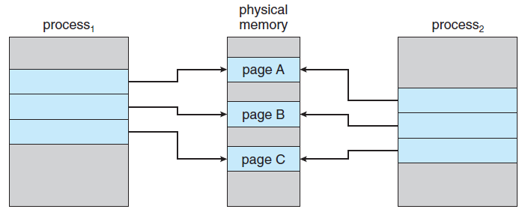
Before Process 1 Modifies Page C
Notes:
34

Slide 35
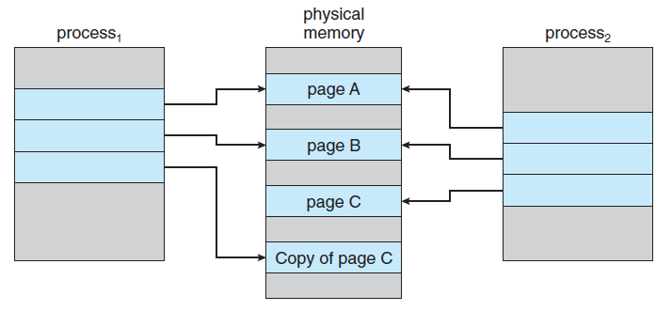
After Process 1 Modifies Page C
Notes:
35

Slide 36
Page Replacement
By allocating memory to processes partially, degree of multiprogramming can be increased
Over-allocation of memory takes place
Processes may demand a larger number of frames than the allocated numbers
I/O buffers are also allocated memory
What happens if a page fault occurs and there are no free frames available?
Solutions
OS terminates the process demanding more frames
Paging should be logically transparent to user
Swap out the process, reducing the degree of multiprogramming
Use page replacement as the solution

Slide 37
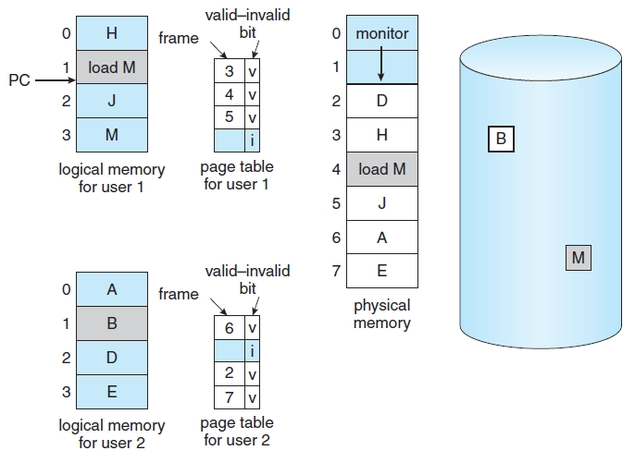
Need For Page Replacement
Notes:
37

Slide 38
Basic Page Replacement
If no frame is free, select a frame that is not currently in use
Write its contents to swap space and change the contents of the page table
Page fault-service routine should include the page replacement step
Two page transfers are done if no frame is free
Page-fault service time doubles
Modify or dirty bit can be used to improve the page-fault service time
The same principle can be applied for read- only pages

Slide 39
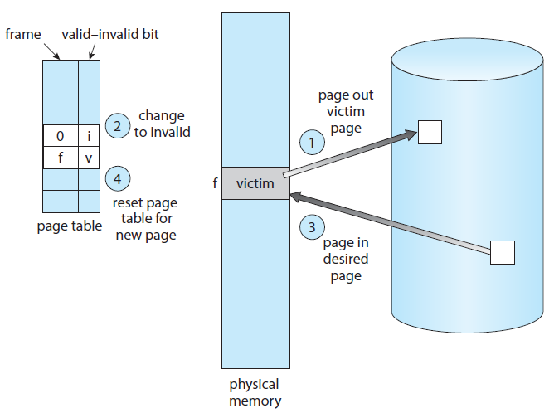
Page Replacement
Notes:
39

Slide 40
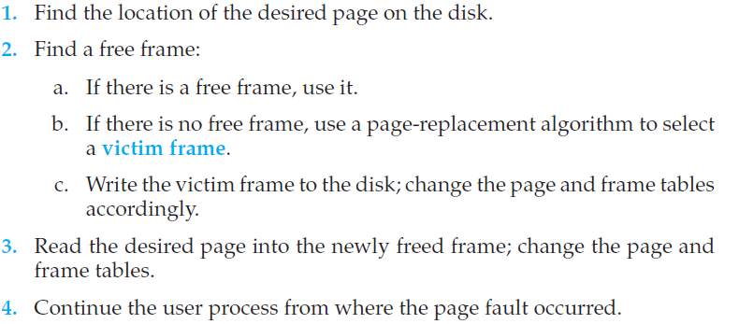
Page fault service routine modified
Notes:
40

Slide 41
Basic Page Replacement
Page replacement is basic to demand paging
There are two issues that need to be resolved
Selection of a frame-allocation algorithm
How many frames to allocate to each process
Selection algorithm for a page to be replaced
How to select a particular page replacement algorithm?
Evaluate an algorithm by taking a reference string and computing the number of page faults
String of memory references while executing a process is referred to as the reference string

Slide 42
Basic Page Replacement
How to generate a reference string?
Generate memory references artificially
Trace a given system and record all memory references
A large amount of data is produced
Two facts can be used to reduce amount of data
For a given page size, consider only the page number
If reference is made to a page p, immediately following references to same page will never cause a page fault
Example addresses converted to a reference string
Number of page fault decreases with the increase in the number of allocated frames

Slide 43

Address sequence converted to a reference string
Notes:
43
100 bytes per page

Slide 44
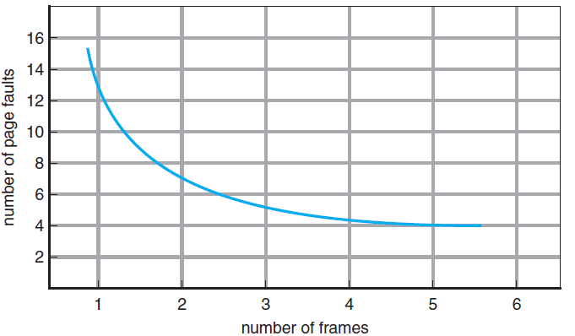
Graph of Page Faults Versus The Number of Frames
Notes:
44

Slide 45
FIFO Page Replacement
The simplest page-replacement algorithm
Associates with each page the time when that page was brought into memory
The oldest page is chosen for replacement
A FIFO queue can be used to serve the same purpose
Example reference string and the corresponding page faults
Performance of FIFO algorithm is not always good
A heavily used page may be replaced
The algorithm suffers from Belady’s anomaly
Consider the reference string
1, 2, 3, 4, 1, 2, 5, 1, 2, 3, 4, 5
The number of page faults increase with the increase in the number of allocated frames

Slide 46
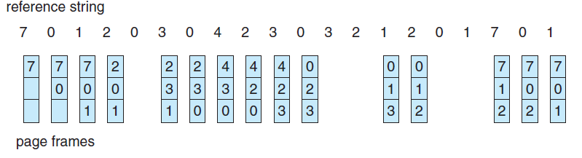
FIFO Page Replacement
Notes:
46

Slide 47
Reference String
Notes:
47

Slide 48
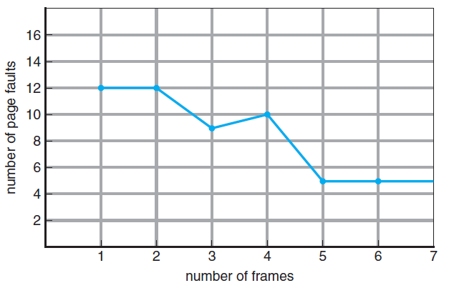
FIFO Illustrating Belady’s Anomaly
Notes:
48

Slide 49
Optimal Page Replacement
This page replacement algorithm has the lowest page-fault rate of all algorithms
It is called OPT or MIN algorithm
Replace the page that will not be used for the longest period of time
Guarantees the lowest possible page-fault rate for a fixed number of frames
Examples reference string and number of page faults
Difficult to implement
Requires future knowledge of the reference string
This algorithm is used mainly for comparison studies

Slide 50
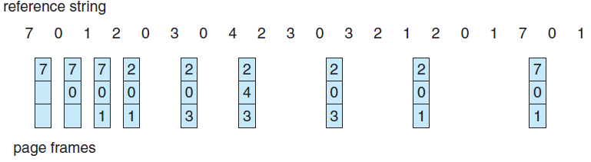
Optimal Page Replacement
Notes:
50

Slide 51
LRU Page Replacement
Replace the page that has not been used for the longest period of time
Least-recently-used page
OPT algorithm looks forward in time
Associate the time of last reference with each page
LRU applied on the reference string
Algorithm that is used to give a good overall performance
Major problem is how to implement the algorithm?
Determine an order for the frames defined by the time of last use
Two implementations are feasible

Slide 52
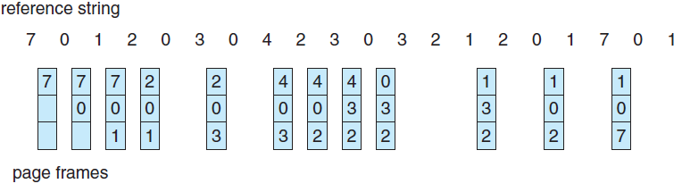
LRU Page Replacement
Notes:
52

Slide 53
LRU Page Replacement
Use of logical clock or counter with the CPU
Time of use field with each page table entry
Use of stack
Counters
Associate with each page-table entry a time-of-use field and a counter or logical clock with the CPU
Working of the scheme
Scheme requires the search of the entire page table
Time must be maintained when page tables are changed
Overflow of the clock must be considered

Slide 54
LRU Page Replacement
Stack
Keep a stack of page numbers
Reference to a page would put its entry on top
Implement as a doubly linked list with a head and a tail pointer
Search of entire table is not required
Approach is appropriate for software or microcode implementation of LRU replacement
OPT and LRU do not suffer from Belady’s anomaly
Both belong to the class of stack algorithms
The set of pages in memory for n frames is always a subset of the set of pages that would be in memory with n+1 frames
Support of hardware is necessary for either implementation of LRU

Slide 55
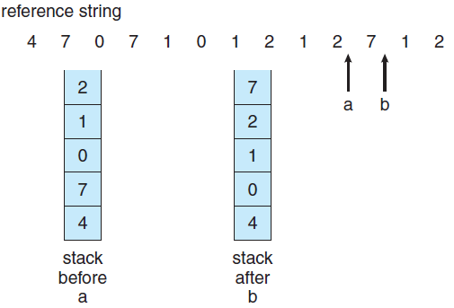
Use Of A Stack to Record The Most Recent Page References
Notes:
55

